Slide 1
SciLifeLab Science for Life Laboratory
Eva Molin, PhD, MEd
Project coordinator

Slide 2
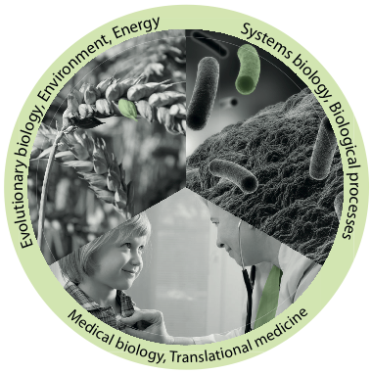
Science for Life Laboratory
Develops, offers and applies
advanced technologies for molecular biosciences with a focus on health and environment
Joint Uppsala – Stockholm center with two nodes
Hosted by four universities
Official start, 1 July 2013
Approximately 1500 researchers by mid 2014
Infrastructure for molecular bioscience
Notes:
SciLifeLab is a center for molecular biosciences with a focus on health and environmental research. This national resource is based on a collaboration between SciLifeLab’s four host universities; Karolinska Institutet,
KTH Royal Institute of Technology, Stockholm University and Uppsala University. SciLifeLab consists of two nodes, located in Stockholm and Uppsala, respectively.
This national center combines frontline technical expertise with deep knowledge of translational medicine and molecular bioscience. Researchers from all over Sweden can use both the technologies and the know-how at SciLifeLab. Most of our users represent academia, but there are also users from industry, healthcare and government agencies.

Slide 3
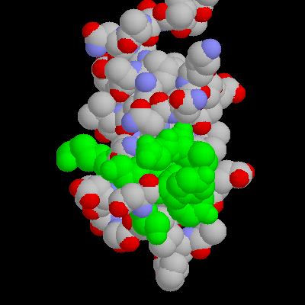
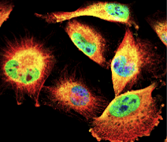

DNA/RNA
Proteins
Cells
Organism
Health
Environment
Notes:
The research at SciLifeLab is performed within two main focus areas: health and environmental research. SciLifeLab gather scientists in a broad range of molecular bioscience research to facilitate networking and multidisciplinary studies. The center has a strong focus on genomics, comparative genetics, proteomics, functional biology and bioimaging.
One important aim of the research at SciLifeLab is to understand, diagnose and treat diseases like cancer, cardiovascular diseases, Alzheimer’s disease and infectious diseases. Identification of genetic risk factors, biomarkers, and molecular mechanisms behind these diseases will give opportunities for early diagnosis, personalized therapy, and identification of novel drug targets.
Another focus is an increased molecular/mechanistic understanding of microbes that can lead to new bioenergy production and new tools to monitor the Baltic Sea.

Slide 4
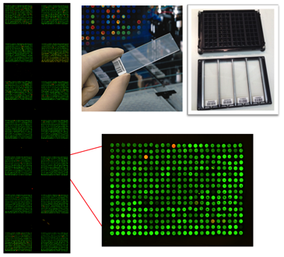
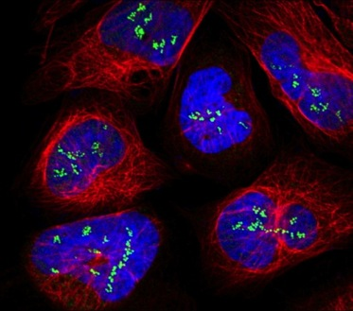
SciLifeLab mission
Technology platforms for national use
Service
Technology Development
Analytical support
Courses and workshops
Generate a strong research environment
Affiliated faculty
SciLifeLab Fellows Program
National projects
International collaborations
Notes:
The technological infrastructure of SciLifeLab is organized into different technology platforms. These platforms, in turn, encompass between one to eight facilities, each with a different specialty. The facilities are responsible for providing service and expertise, education and technology development on a nationwide scale. During 2013 the SciLifeLab technology platforms performed 2,235 projects for clients. Of these projects 27% were assigned from a client outside the SciLifeLab host universities.
SciLifeLab aims to create a strong research community around the national center through education and collaborative exchange. We also facilitate collaborations between stakeholders in the life science sector, for instance researchers, healthcare, governmental agencies and companies.
SciLifeLab researchers and platform personnel have been involved in undergraduate courses covering a wide range of subjects, including nanotechnology, bioinformatics, bioimaging, microbiology, infection biology, genomics, biomarkers, model systems, cancer genetics and tumor biology.
Many of the technology platforms at SciLifeLab have also developed new advanced courses at the doctoral level, to provide training in techniques and analyses. One major focus has been to educate researchers in bioinformatics and bioinformatics software, to enable them to handle the large amount of data generated.
NATIONAL PROJECTS
In 2013 SciLifeLab started preparations for a nationwide call for proposals for genome projects, providing researchers from all parts of Sweden the possibility to finance and perform large-scale genome studies, i.e. sequencing of the whole genome from several individuals or organisms. The call will be launched early 2014 and successful applicants will be selected in a peer review process with external reviewers. This effort is one way for SciLifeLab to continually develop and maintain a national network of life science researchers, while at the same time providing major benefits to the participating research groups.
INTERNATIONAL COLLABORATIONS
Broad Institute
Sanger Center
FELLOWS PROGRAM
Strategic recruitments

Slide 5
Upcoming courses
Date | Course
October 12-17 | Perl Programming with Application to Bioinformatics
October 20-22 | RNA-seq
November 16-17 | Genome Assembly
November 24-25 | Metagenomics
Application Nov/Dec | The Swedish Bioinformatics Advisory Program
Notes:
The technological infrastructure of SciLifeLab is organized into different technology platforms. These platforms, in turn, encompass between one to eight facilities, each with a different specialty. The facilities are responsible for providing service and expertise, education and technology development on a nationwide scale.
NATIONAL AND REGIONAL
SciLifeLab has nine national platforms. The new SciLifeLab Board has appointed a steering board for each national platform. These boards have national representation and will oversee the platform’s activities, and ensure that platform services are in demand from potential users in Sweden. The process of establishing the platform steering boards began in 2013, and they will be fully in place by early 2014. Each national facility has been approved by the national board, based on the evaluation process carried out by the National Reference Committee in 2013.
The regional facilities of national interest are funded from other sources than the national infrastructure grant. However, these facilities still also offer service and technology for researchers outside the Stockholm-Uppsala region.

Slide 6


Science & SciLifeLab Prize for Young Scientists
Annual prize starting in 2013
Four areas in life science
Prize winners selected by Science editorial board
Winners essay published in Science
scienceprize.scilifelab.se
Notes:
SCIENCE AND SCILIFELAB PRIZE
– RECOGNIZING AND
REWARDING YOUNG TALENT
In 2013 SciLifeLab, together with one of the leading scientific journals, Science, recognized excellence amongst young researchers by establishing the Science and SciLifeLab Prize for Young Scientists. It is a global prize, awarded yearly to celebrate and support recent PhD graduates at the start of their careers.
Each contestant enters the competition by submitting an essay on their thesis and its implications for life science.
The first-ever winner of the award, Daniel Streicker, who received his PhD from the Odum School of Ecology at the University of Georgia in the US, had his essay published in the journal Science and received a prize of $25,000. The three runners up received a combined total of an additional $10,000 in prize money and were published online in Science.

Slide 7
www.scilifelab.se

